Slide 1


University of Pretoria
Faculty of Health Sciences
School of Health Systems & Public Health
HEALTH PROMOTION (SCP 872)
Intervention Plan: Decrease HIV Infection among Men Who Sleep with Men and Transgender Women
Student name: Sthabiso Bohlela
Student no: u22680642

Slide 2

Outline:
• Background
• Problem
• Intervention Plan
• Evaluation Plan
• Conclusion

Slide 3

Background:
The Aurum Institute introduced the POP INN program in October 2019, in response to the rising HIV and STI rates among men who sleep with men (MSM) and transgender women (TGW).
POP INN is specifically tailored to address the unique challenges and vulnerabilities that MSM and TGW populations face.
The program aims to combat unprotected sex and promote health and well-being among these populations by offering a wide range of services.
A key focus of POP INN is providing HIV testing services, PrEP, Condoms, immediate initiation of antiretroviral treatment, etc.
POP INN was implemented as POP INN Clinic, which is a facility that renders these services.

Slide 4
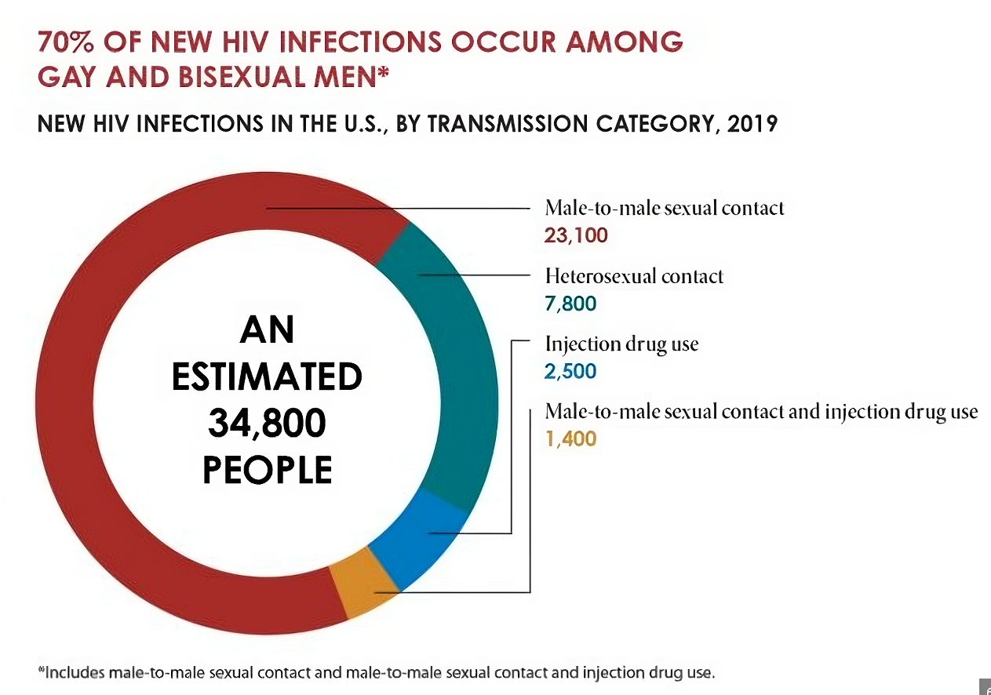
Problem:
HIV among Gay and Bisexual men in the U.S. | Factsheet | Newsroom | NCHHSTP | CDC
Rising HIV infection rates in MSM and TGW are a major public health concern, driven by various factors.
Causes of the problem include behavioral risks (like inconsistent condom use) and environmental risks (such as societal attitudes and healthcare barriers).
Behavioral determinants include stigma and masculinity norms for MSM and transphobia for TGW, while environmental determinants encompass discrimination and restricted healthcare access.

Slide 5



Intervention Plan Project: Protect4Life
This intervention is a response to the alarming prevalence of HIV within the MSM and TGW communities.
This intervention is crucial to mitigate the ongoing spread of HIV and improve the overall health of the LGBTQ+ Community.

Slide 6

Goal:
To Decrease HIV Infection among Men Who Sleep with Men and Transgender Women
This intervention aims to empower these communities with:
Supportive environment
Knowledge
Resources

Slide 7
Objectives:
Provide pre-exposure prophylaxis to 100% of eligible MSM and TGW within the target population by the end of 2024.
Implement a comprehensive HIV education program reaching 90% of the MSM and TGW population by the end of 2024.
Increase condom usage by 30% in MSM and TGW by the end of 2024.
Increase access to comprehensive HIV prevention and treatment services for MSM and TGW, resulting in a 20% increase in utilization by the end of 2024.

Slide 9



Variable | Evaluation Question | Indicator | Data Source | Timing
PrEP uptake | What is the level of PrEP uptake within the target population? | Number of eligible individuals initiated on PrEP. | Health Records PrEP distribution logs/register. | Monthly
Knowledge level of MSM and TGW about HIV prevention and treatment. | How much has the HIV education program improved HIV prevention and treatment knowledge in the target population? | Percentage increase in knowledge about HIV prevention and treatment within the target population. | Surveys | Baseline Quarterly
Condom usage rate | How much has condom usage increased due to the intervention? | Percentage increase in condom usage. | Surveys Self-reported data | Baseline Monthly
Utilization of HIV prevention and treatment services | How much has the intervention boosted the utilization of HIV prevention and treatment services? | Percentage increase in the utilization rate of HIV prevention and treatment services. | Records from the register Surveys Self-reported | Baseline Monthly
Evaluation
Plan

Slide 10
Conclusion:
• In conclusion, this intervention represents our commitment to combat the alarming HIV prevalence among MSM and TGW communities.
• This intervention is not just a response; it is a lifeline for MSM and TGW individuals facing disproportionate risks. It is essential in our collective effort to halt the spread of HIV within these communities.

Slide 11
Thanks For Watching

